Slide 1
‘ Cognition in MS with reference to BICAMS Dawn Langdon PhD
1

Slide 2
cognition in multiple sclerosis
Impact and pattern of cognitive difficulties in MS
Relation to physical disease
Measurement of cognition
BRB-N
Recent findings and future directions
Global perspective
BICAMS

Slide 3
How do cognitive problems affect the lives of people with MS?
Participation | Safety | Disease
Employment | Driving | Medical decisions
Relationships | Falls | Medication adherence
Social function |  | Rehabilitation benefit
Daily activities |  | Symptom management
Physical independence |  | Coping
Leisure activities
Mood
 | General
Life satisfaction
Health-related Quality of Life
Quality of Life
Langdon DW. Cognition in multiple sclerosis. Curr Opin Neurol. 2011 Jun;24(3):244-9.

Slide 4
Cognitive dysfunction in MS: Prevalence of impairment by cognitive domain
35%
30%
25%
20%
Percentage of MS group scoring
<5th percentile for healthy controls
22–31%
22–25%
15%
10%
13–19%
12–19%
5%
8–9%
7–8%
0%
Memory
Information
Processing
Speed
Problem
Solving
Visuospatial
Abilities
Language
Simple
Attention
Adapted from Rao et al. Neurology, 1991;41:685–691.
4
Notes:
Slide 3
MS-related CD is generally circumscribed, not global. Recent memory and information processing are the most frequently affected domains (with impairment observed in 22%-31% of patients in the study by Rao et al 1991). Memory deficits are reported by patients as forgetfulness, especially with recall of recently learned verbal or visual information. Information processing deficits result in increased distractibility and/or a slowing of mental functioning. This makes it difficult for the patient to focus on more than one task at a time.
Problem solving (ie, executive functions) and visuospatial abilities are the next most commonly affected domains. Patients struggle to complete tasks in an orderly fashion or start several tasks without finishing any one of them. On formal testing they have difficulty developing, testing, and shifting problem-solving strategies. Visual-perceptual, constructional, and visuospatial skills are affected almost as frequently as executive functions.
Lastly, MS less commonly affects language (verbal abilities) and simple attention span. Although patients often describe “inattentiveness,” they are usually referring to an inability to sustain and focus attention over time; often related to information processing deficits and more appropriately termed “complex attention.”
Rao SM, Leo GJ, Bernardin L, Unverzagt F. Cognitive dysfunction in multiple sclerosis. I. Frequency, patterns, and prediction. Neurology 1991;41:685-691.

Slide 5
Numbers (%) of patients impaired (<5 percentile)
 | CIS (n=33) | RR (n=75) | PP (n=23) | SP (n=29)
SRTL | 4 (12.1) | 16 (21.3) | 8 (34.8) | 16 (55.2)
SRTC | 2 (7.5) | 17 (22.0) | 8 (34.5) | 12 (40.2)
SRTD | 4 (12.8) | 14 (19.0) | 4 (19.4) | 13 (46.0)
SPARTi | 4 (12.1) | 10 (12.7) | 7 (30.1) | 9 (29.8)
SPARTd | 9 (27.3) | 21 (28.0) | 9 (30.1) | 16 (55.2)
SDMT | 5 (14.2) | 21 (27.7) | 14 (62.6) | 22 (75.8)
PASAT 3 | 6 (19.6) | 17 (22.0) | 10 (43.2) | 14 (47.1)
PASAT 2 | 5 (16.6) | 17 (22.0) | 8 (34.5) | 13 (43.6)
WLG | 11 (33.3) | 28 (37.3) | 13 (56.5) | 13 (44.8)
0-25% 26-50% 51-100%
Potagas et al. J Neurol Sci 2008; 267:100-106

Slide 6
Relation to physical disease

Slide 7
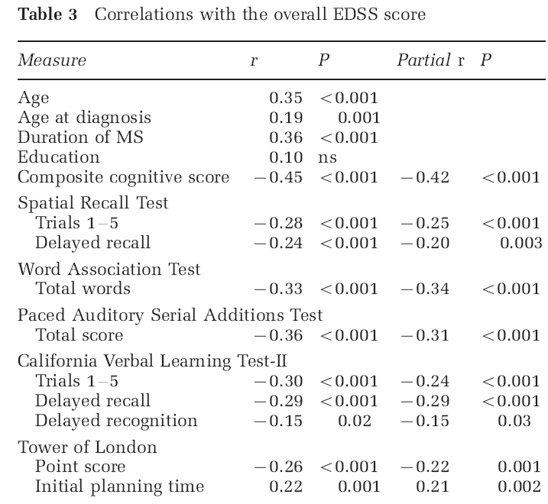
Relation of cognition to disability
Lynch SG, Parmenter BA, Denney DR. The association between cognitive impairment and physical disability in multiple sclerosis. Mult Scler. 2005 Aug;11(4):469-76.

Slide 8
Cognitive impairment predicts conversion to multiple sclerosis in clinically isolated syndromes
Zipoli V, Goretti B, Hakiki B, Siracusa G, Sorbi S, Portaccio E, Amato MP.
Mult Scler. 2010 Jan;16(1):62-7.

Slide 9
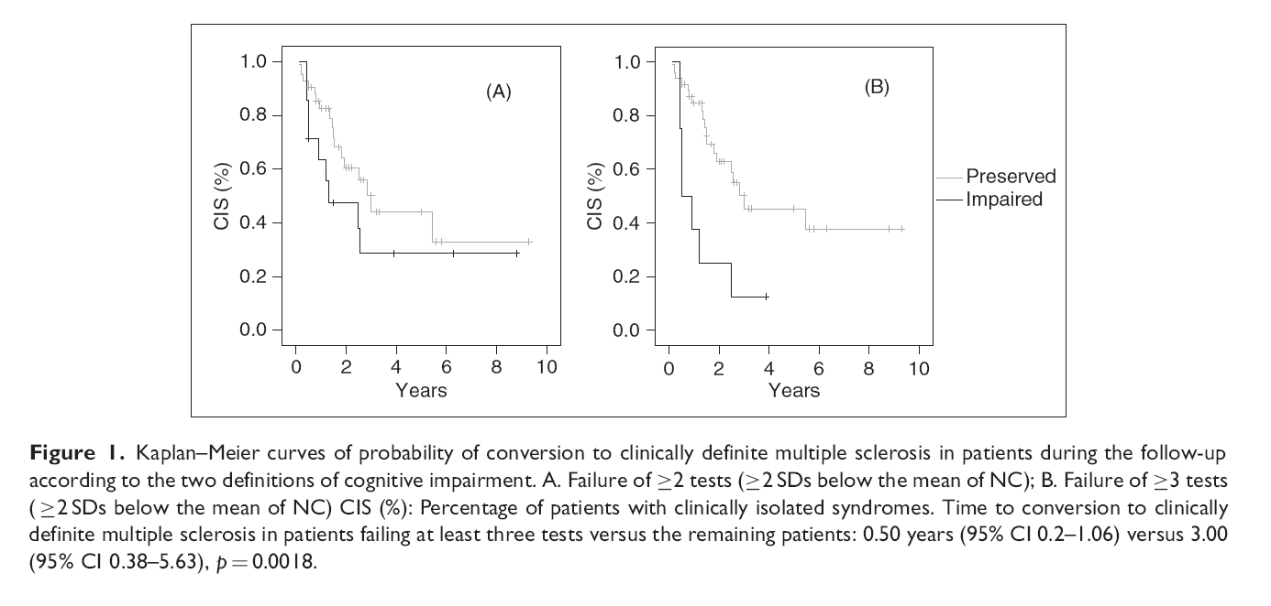
Cognitive impairment predicts conversion to multiple sclerosis in clinically isolated syndromes
Zipoli V, Goretti B, Hakiki B, Siracusa G, Sorbi S, Portaccio E, Amato MP.
Mult Scler. 2010 Jan;16(1):62-7.

Slide 10
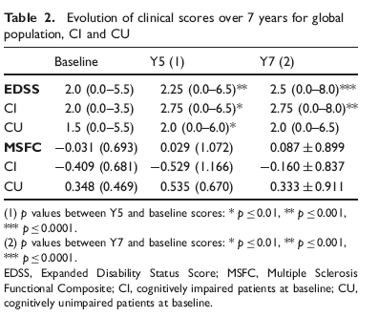
Early cognitive impairment in multiple sclerosis predicts disability outcome several years later.
Deloire M, Ruet A, Hamel D, Bonnet M, Brochet B.
Mult Scler. 2010; 16(5):581-7

Slide 11
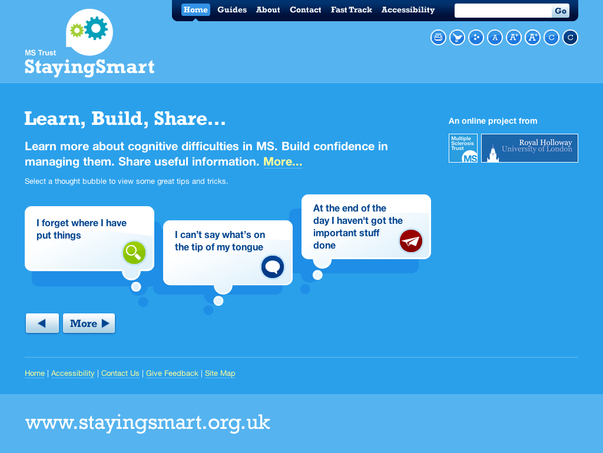
11

Slide 12
Assessment of Cognition
MSNQ
Screening tests
Routine in the office
BRB
SEFCI
Brief Batteries
Routine NP exam.
MACFIMS
Intermediate length Batteries
Differential diagnosis
Disability questions
Rehabilitation programs
Ad hoc
Comprehensive Batteries
12

Slide 13
Self-report of cognition in MS
MSNQ sample items
Is easily distracted
Loses focus when listening
Is slow when problem solving
Forgets appointments
Must be reminded to do tasks
Benedict RH. Integrating cognitive function screening and assessment into the routine care of multiple sclerosis patients. CNS Spectr. 2005 May;10(5):384-91.
13

Slide 14
Subjective report of cognitive dysfunction
Test | Mean (SD) | Correlation with patient report | Correlation with informant report
Beck Depression Inventory | 10.2 (6.9) | 0.53* | ns
Beck Depression Inventory | 10.2 (6.9) | 0.53* | ns
Centre for epidemiologic depression scale | 19.6 (6.0) | 0.46* | ns
Centre for epidemiologic depression scale | 19.6 (6.0) | 0.46* | ns
Boston Naming Test | 54.3 (6.2) | ns | -0.45**
Boston Naming Test | 54.3 (6.2) | ns | -0.45**
Judgement of Line Orientation | 21.7 (6.6) | ns | ns
Judgement of Line Orientation | 21.7 (6.6) | ns | ns
CVLT-II total recall | 44.8 (10.4) | ns | -0.53*
CVLT-II total recall | 44.8 (10.4) | ns | -0.53*
CVLT-II delayed recall | 9.4 (3.4) | ns | -0.43**
CVLT-II delayed recall | 9.4 (3.4) | ns | -0.43**
BVMT-R total recall | 16.1 (7.3) | ns | ns
BVMT-R total recall | 16.1 (7.3) | ns | ns
BVMT-R delayed recall | 6.6 (3.1) | ns | -0.43**
BVMT-R delayed recall | 6.6 (3.1) | ns | -0.43**
Trail-making part B | 123.2 (106.5) | ns | 0.55*
Trail-making part B | 123.2 (106.5) | ns | 0.55*
Paced Auditory Serial Addition Test | 32.6 (13.9) | ns | -0.47**
Paced Auditory Serial Addition Test | 32.6 (13.9) | ns | -0.47**
WCST perseverations | 19.6 (19.1) | ns | 0.37**
WCST perseverations | 19.6 (19.1) | ns | 0.37**
*p<0.01; **p<0.001; ns=non-significant
Screening for multiple sclerosis cognitive impairment using a self-administered 15-item questionnaire. Benedict RH, Munschauer F, Linn R, Miller C, Murphy E, Foley F, Jacobs L. Mult Scler. 2003 Feb;9(1):95-101.

Slide 15
BRB-N

Slide 16
Selective Reminding Test
Benedict et al. Clin Neuropsychol 2002; 16: 381-97

Slide 17
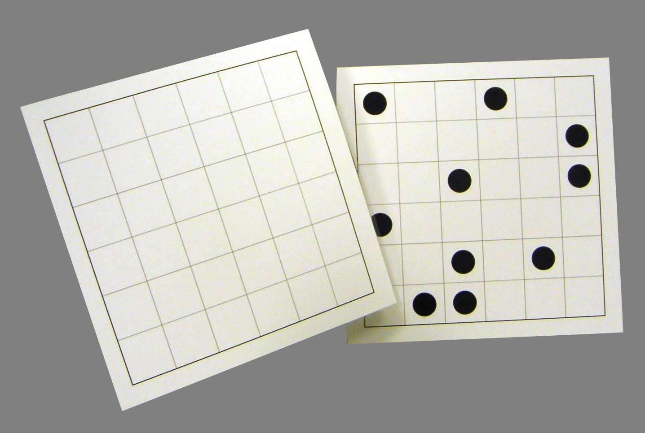
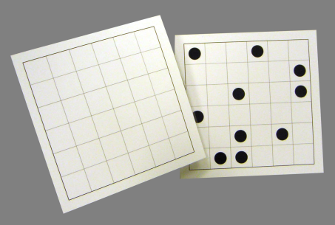
10/36 Spatial Recall Test
Benedict et al. Clin Neuropsychol 2002; 16: 381-97

Slide 18
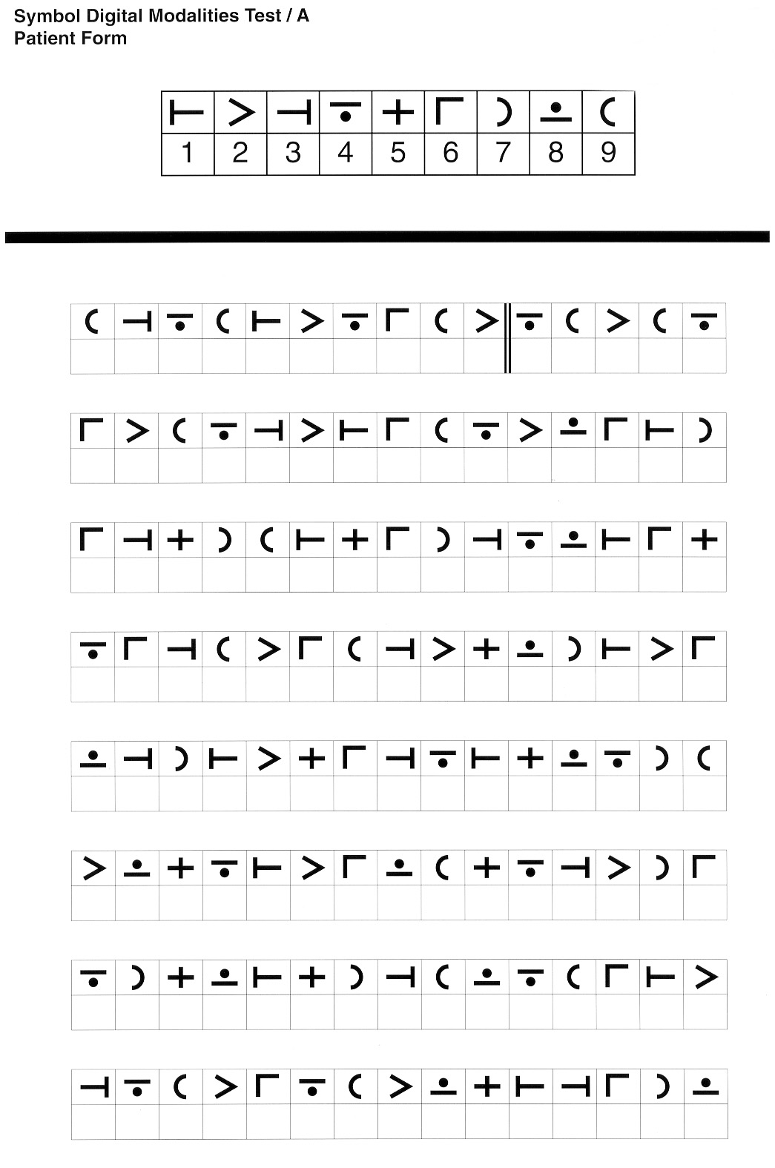
Symbol Digital Modality Test / A
Benedict et al. Clin Neuropsychol 2002; 16: 381-97

Slide 19
Paced Auditory Serial Addition Test
Benedict et al. Clin Neuropsychol 2002; 16: 381-97

Slide 20
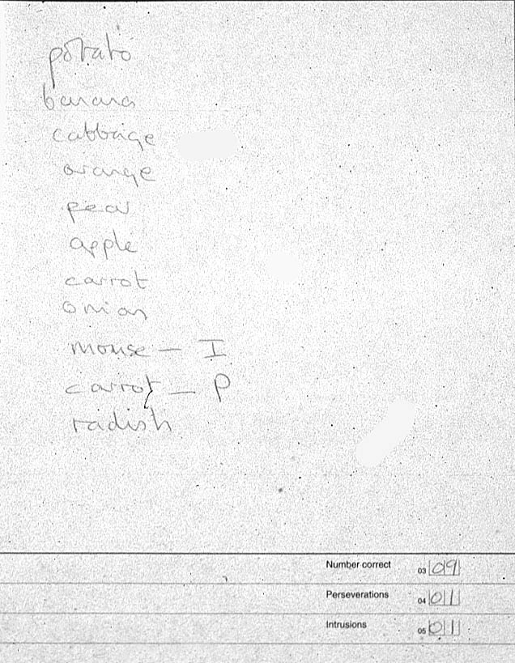
Verbal fluency
Benedict et al. Clin Neuropsychol 2002; 16: 381-97

Slide 21
Recent findings and future directions

Slide 22
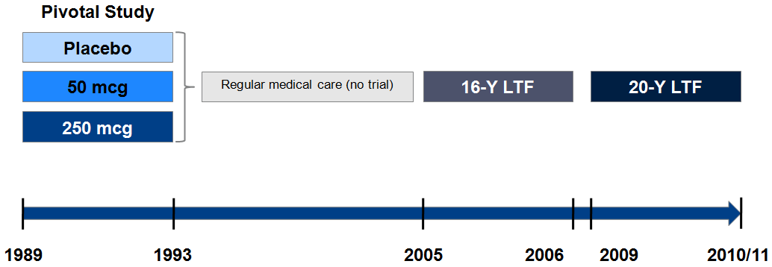
IFNB-1b long term follow-up study design
↑ ↑
Ebers et al. JNNP 2010; 81: 907-12
Ebers et al. Clin Ther 2009; 31: 1724-36
Reder et al. Neurology 2010; 74: 1877-85
Study funded by Bayer Healthcare

Slide 23
Correlations of cognitive test scores with concurrent neurological variables in advanced disease
 | Current EDSS | Current T2 BOD (mm³) | Current T1 black hole (mm³) | Normalised brain volume (%)
PASAT-3” | –0.274*** | –0.260** | –0.288** | 0.494***
COWAT | –0.375*** | –0.476*** | –0.467*** | 0.400***
SDMT | –0.455*** | –0.582*** | –0.552*** | 0.614***
CVLT-II | –0.244** | –0.383*** | –0.316*** | 0.316***
D-KEFS | –0.219** | –0.352*** | –0.368*** | 0.342***
Cognitive performance index | –0.398*** | –0.504*** | –0.503*** | 0.549***
*p<0.05; **p<0.01; ***p<0.001.
BOD, burden of disease; EDSS, Expanded Disability Status Scale; MRI, magnetic resonance imaging.
Pearson partial correlation coefficients of cognitive raw scores and performance index
with current EDSS and MRI values
Langdon et al., 2010

Slide 24
Early disease characteristics are only significant independent predictors of cognition at 16 years
 |  | Estimate | Standard error | p-value
 | Intercept | –14.9666 | 3.5968 | <0.0001
Reserve | Pre-morbid IQ | 0.1495 | 0.0331 | <0.0001
Disability | EDSS at baseline | –0.9572 | 0.2413 | 0.0001
Lesions | MRI T2 BOD at baseline (mm²) | –0.0009 | 0.0002 | <0.0001
Disability | Change in EDSS from baseline to last visit after 2 years | –0.4642 | 0.2371 | 0.0526
Lesions | MRI T2 activity at Year 2 | –0.2314 | 0.0881 | 0.0098
Fitted linear regression model, using p=0.10 to stay in the model. Model fit: R²=0.4452
BOD, burden of disease; EDSS, Expanded Disability Status Scale; MRI, magnetic resonance imaging.
Study funded by Bayer Healthcare
Langdon et al., 2010

Slide 25
“Cognitive MS”
Case reports of individuals presenting with debilitating cognitive dysfunction
Relative absence of physical motor or sensory impairments
May remain undiagnosed or misdiagnosed for years
Larner A, Young C. Acute amnesia in MS revisited. Int MS J 2009;16:102-4.
Staff N, Claudia X, Lucchinetti C, et al. Multiple sclerosis with predominant, severe cognitive impairment. Arch Neurol 2009;66:1139-43.
Zarei M, Chandran S, Compston A, et al. Cognitive presentation of multiple sclerosis: evidence for a cortical variant. J Neurol Neurosurg Psychiatry 2003;74:872-7.
Zarei M. Clinical characteristics of cortical multiple sclerosis. J Neurol Sci 2006;245:53-8.
Ferraro D, Maria Simone A, Merelli E, et al. Isolated progressive cognitive impairment and depression in a patient with neuroradiological features suggestive of multiple sclerosis. Neurol Sci 2011;32:695-7.
Fontaine B, Seilhean D, Tourbah A, et al. Dementia in two historically confirmed cases of multiple sclerosis: one case with isolated dementia and one case associated with psychiatric symptoms. J Neurol Neurosurg Psychiatry 1994;57:353-9.
Stoquart-Elsankari S, Perin B, Lehmann P, et al. Cognitive forms of multiple sclerosis: report of a dementia case. Clin Neurol Neurosurg 2010;112:258-60.
Vighetto A, Charles N, Salzmann M, et al. Korsakoff's syndrome as the initial presentation of multiple sclerosis. J Neurol 1991;238:351-4.

Slide 26
Comparison of “cognitive MS”, typical MS and healthy volunteers
Merrett et al., 2011

Slide 27
Comparison of “cognitive MS”, typical MS and healthy volunteers
Merrett et al., 2011

Slide 28
BICAMS

Slide 29
Cognitive assessment for MS
Requires specialist training
Time-consuming
Not routinely available outside specialist centres
Not comparable across countries
29

Slide 30
BICAMS Brief International Cognitive Assessment for MS
Identify a brief assessment tool for cognition in MS
can be used by health care professionals who are not cognitive specialists
has international validation
Specify an international validation protocol that can be implemented in any country
Agree guidelines on test-retest timing and clinically significant change
BICAMS committee meetings and website are sponsored by Bayer Healthcare
30

Slide 31
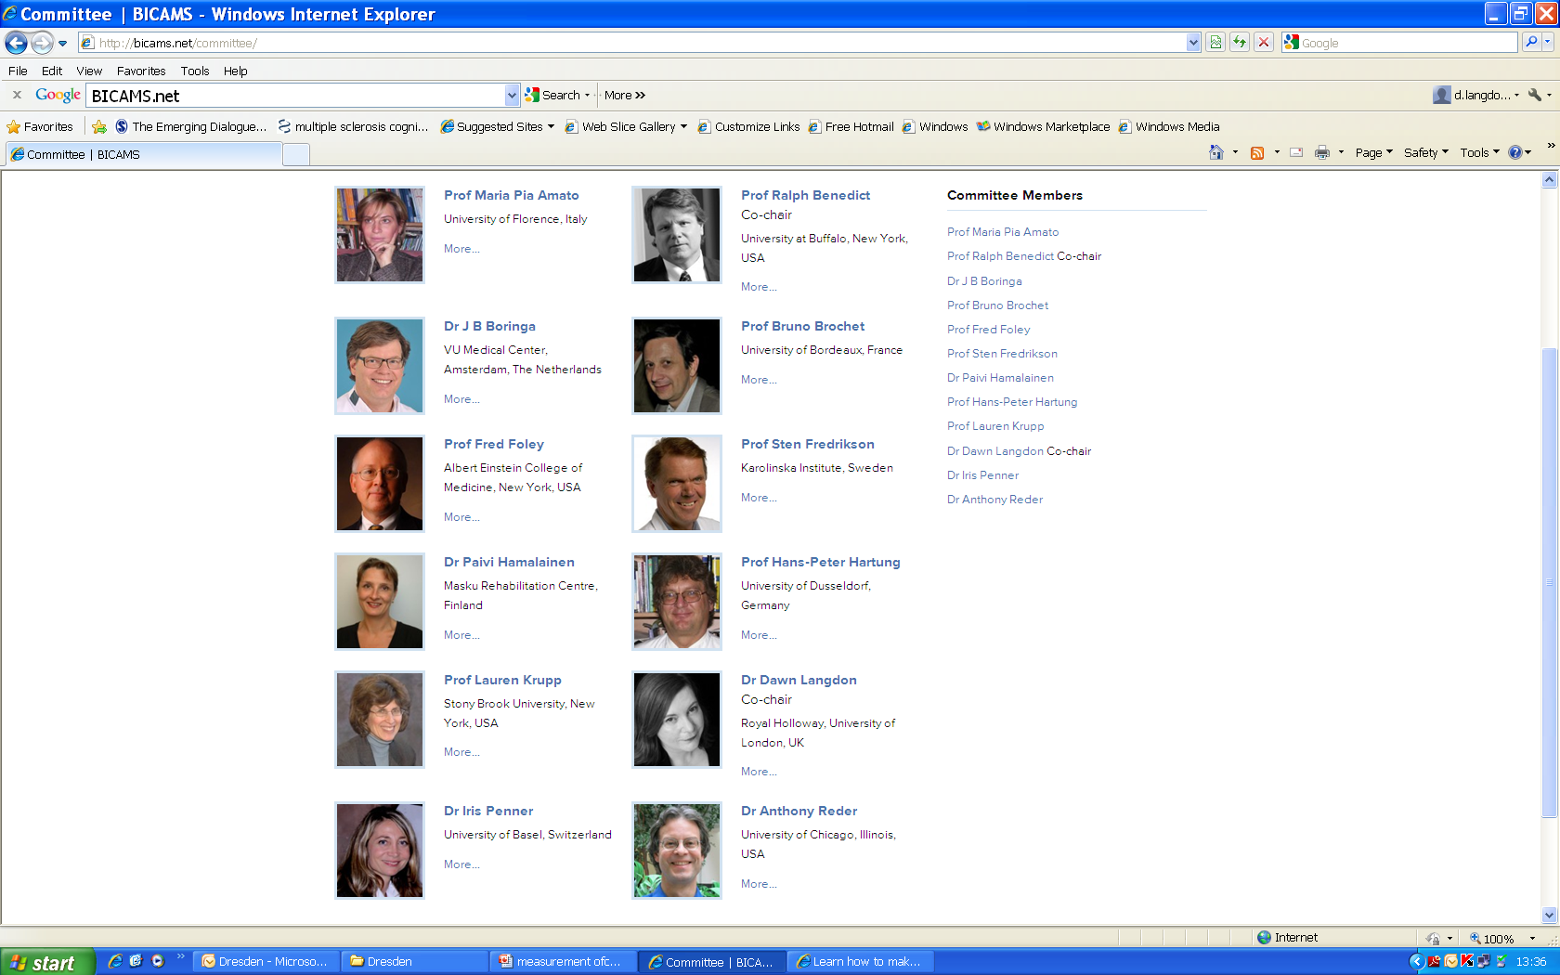
BICAMS.net
BICAMS committee meetings and website are sponsored by Bayer Healthcare
31

Slide 32
BICAMS Brief International Cognitive Assessment for MS
Identify a brief assessment tool for cognition in MS
80 key scientific articles identified
Each article rated by two committee members
Psychometric standards
Reliability
Validity
Sensitivity
Pragmatic standards
International applicability
Ease of administration
Feasibility in the specified context
Acceptability to patients
BICAMS committee meetings and website are sponsored by Bayer Healthcare
32

Slide 33
BICAMS consensus criteria
Completed in 15 minutes
No special equipment (beyond pen, paper, stopwatch)
No specific assessor training for graduate health professionals
Easily performed in a clinical setting
Domains included:
Information processing speed
Verbal memory
Visual memory
Langdon et al., Recommendations for a Brief International Cognitive Assessment for Multiple Sclerosis (BICAMS). MSJ 2012;18:891-1.

Slide 34
BICAMS mean ratings
Information processing speed
SDMT
Psychometric mean 2.8
Pragmatic mean 3.0
PASAT
Psychometric mean 2.6
Pragmatic mean 1.9
Verbal memory
CVLT-II
Psychometric mean 2.9
Pragmatic mean 2.6
SRT
Psychometric mean 2.5
Pragmatic mean 2.2
Visual memory
BVMT-R
Psychometric mean 3.0
Pragmatic mean 2.2
10/36
Psychometric mean 2.3
Pragmatic mean 2.6
Langdon et al., Recommendations for a Brief International Cognitive Assessment for Multiple Sclerosis (BICAMS). MSJ 2012;18:891-1.

Slide 35
Symbol Digital Modality Test / A
Benedict et al. Clin Neuropsychol
2002; 16: 381-97
35

Slide 36
California Verbal Learning Test-II (CVLT II)
Truck
Spinach
Giraffe
Bookcase
Onion
Motorcycle
Cabinet
Zebra
Coach
Lamp
Celery
Cow
Desk
Boat
Squirrel
Cabbage
Benedict et al. Clin Neuropsychol 2002; 16: 381-97
36

Slide 37
Brief Visuospatial Memory Test (Revised)
RHB Benedict (Clin Neuropsych 1994; Psychol Assess 1996;
Psychol Assess Resources 1997).
Benedict et al. Clin Neuropsychol 2002; 16: 381-97
37

Slide 38
BICAMS Brief International Cognitive Assessment for MS
Battery
SDMT
CVLT-II, first 5 recall trials
BVMTR, first 3 recall trials
BICAMS committee meetings and website are sponsored by Bayer Healthcare
38

Slide 39
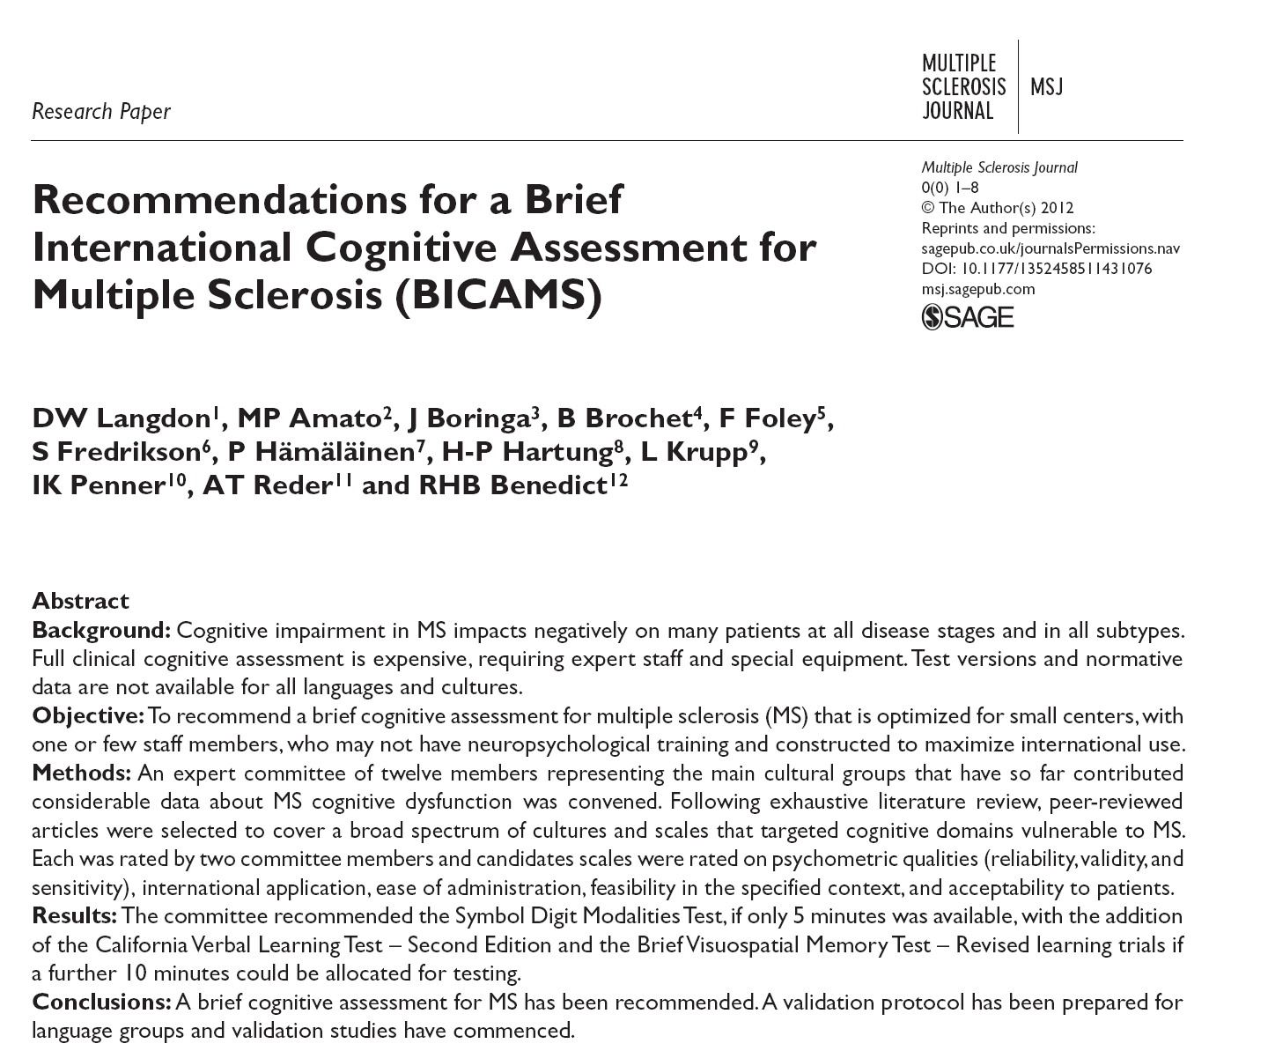
BICAMS committee meetings and website are sponsored by Bayer Healthcare
39

Slide 40
Validity of BICAMS tests confirmed by routine 3T imaging
25 MS patients assessed on large battery
SDMT correlated with
Cortical lesion number
Cortical lesion volume
White matter lesion volume
CVLT-2 (immediate and delayed scores) correlated with
Cortical lesion number
BVMT-R (immediate and delayed scores) correlated with
Cortical lesion volume
White matter lesion volume
Mike et al., Identification and clinical impact of multiple sclerosis cortical lesions as assessed by routine 3T MR imaging. AJNR. 2011;32:515-21

Slide 41
Validity of BICAMS tests confirmed by routine 3T imaging after correction for age, depression and pre-morbid intelligence
SDMT correlated with
Cortical lesion number R² = 0.513, p = .0002
Cortical lesion volume R² = 0.449, p = .0008
White matter lesion volume R² = 0.418, p = .0014
CVLT-2 (immediate and delayed scores) correlated with
Cortical lesion number R² = 0.542, p = .013 (immediate recall)
R² = 0.461, p = .043 (delayed recall)
BVMT-R (immediate and delayed scores) correlated with
Cortical lesion volume NS
White matter lesion volume NS
Mike et al., Identification and clinical impact of multiple sclerosis cortical lesions as assessed by routine 3T MR imaging. AJNR. 2011;32:515-21

Slide 42
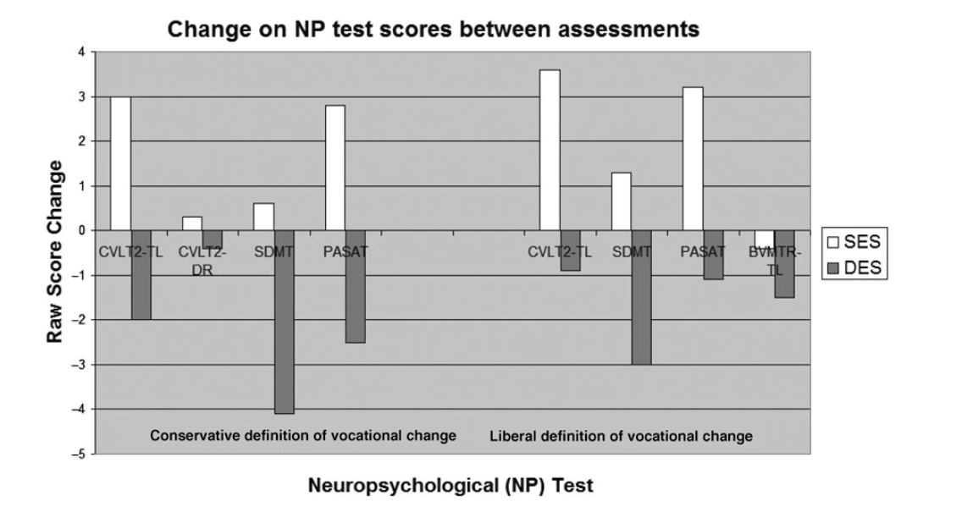
Morrow et al., Predicting loss of employment over three years in multiple sclerosis: clinically meaningful cognitive decline. Clin Neuropsychol 2010:24;1131-45.

Slide 43
BICAMS Brief International Cognitive Assessment for MS
Identify a brief assessment tool for cognition in MS
can be used by health care professionals who are not cognitive specialists
has international validation
Specify an international validation protocol that can be implemented in any country
BICAMS committee meetings and website are sponsored by Bayer Healthcare
43

Slide 44
BICAMS - Brief International Cognitive Assessment for MS International validation protocol
Step 1, Standardization and Translation of Test Stimuli.
Step 2, Standardization and Translation of Test Instructions
Step 3, Normalization
Step 4, Test-Retest Reliability
Step 5, Criterion-Related Validity
BICAMS committee meetings and website are sponsored by Bayer Healthcare
44

Slide 45
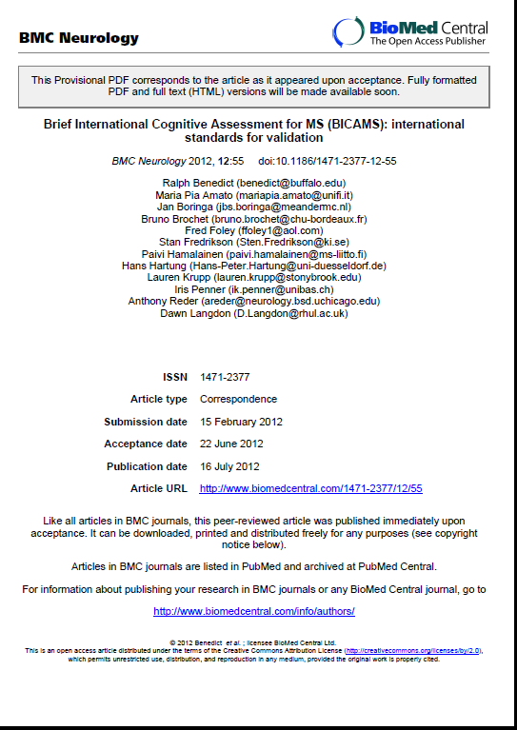

Slide 46
BICAMS Brief International Cognitive Assessment for MS
Identify a brief assessment tool for cognition in MS
can be used by health care professionals who are not cognitive specialists
has international validation
Specify an international validation protocol that can be implemented in any country
Agree guidelines on test-retest timing and clinically significant change
BICAMS committee meetings and website are sponsored by Bayer Healthcare
46

Slide 47
BICAMS national validations
Published | Collecting data/analysis | Discussion
USA | Canada | Portugal | Peru
Iran | UK | Belgium | Oman
Czech Republic | Italy | Ireland | Poland
 | Germany | Hungary | Romania
 | Austria | Australia | Slovenia
 |  | Egypt | Sweden
 |  | Estonia | Turkey
 |  | Lithuania | Brazil
 |  | Norway

Slide 48
BICAMS: improving quality of healthcare and research in MS cognition
Increasing patient access and equality
Cognitive assessment can be accessed by MS patients who do not attend specialist centres
Increased awareness of cognitive issues in health services, leading to better management
Psychometrically sound MS cognitive assessment available in many more countries
Improving research
Cognitive data can be collected for national and international databases
Multinational studies can utilise comparable cognitive data

Slide 49
Assessment of Cognition
Routine in the office
Screening tests
Screening tests
0 mins
Routine in the clinic
BICAMS
15 mins
Brief Batteries
Brief Batteries
45 mins
Routine NP exam
Intermediate length Batteries
90 mins
Differential diagnosis
Disability questions
Rehabilitation programs
Comprehensive Batteries
120 mins
49

Slide 50
Disclosures
Research contracts/sponsorship/speaker bureau/consultancy:
Bayer Healthcare
Biogen IDEC
European Charcot Foundation
Merck Serono
Novartis
Serono Symposia
Teva GmbH
Sanofi-Aventis
Grants:
MS Society
MS Trust
NHS Executive
Swiss MS Society
St George’s/RHUL Studentship
University of London Central Research Fund

